Slide 1


Hadith Series
40 Ahadith Compilation

Slide 2
Introduction to the book
The Author & the Book • Author: ‘Ali ibn Sultan Muhammad, also known as Mulla ‘Ali al-Qari
• Made hijra to Makkah from Herat • His teacher: Ibn Hajar al-Haytami
Famous works: Mirqat al-Mafatih Sharh Mishkat al-Masabih and many more!
• Passed away in Shawwal of 1014AH, buried in Makkah
• Why forty hadith?
- Many hadith mention the excellence of compiling forty
- Hadith included in Mulla ‘Ali al-Qari’s collection are concise
- Profound meaning in few words
- Easy to memorize/snippets of Hadith
Notes:
This is a note to learn

Slide 3
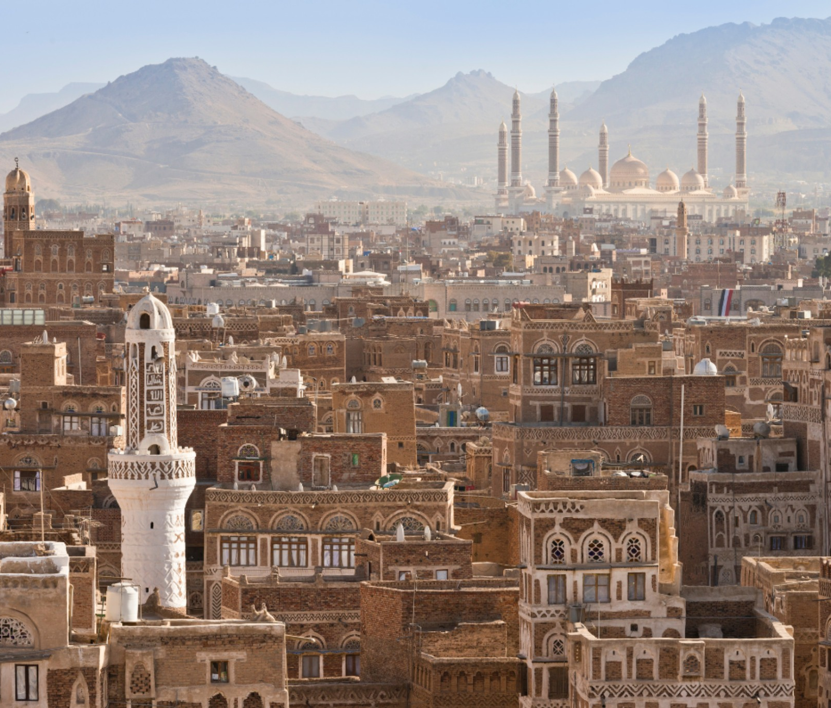
Hadith 1:
“Pride and arrogance are characteristics of the rural Bedouins, while calmness is found amongst the owners of sheep. Faith is Yemeni, and Wisdom is also Yemeni”

Slide 4

Hadith 1: Faith is Yemeni الإِيمَانُ يَمَانٍ
The Prophet's words
The Prophet (saw) said, "Faith (Iman) is Yemeni, understanding (Fiqh) is Yemeni and wisdom (Hikmah) is Yemeni".
The Prophet's actions
The Prophet (saw) also pointed towards Yemen and said, “Faith is there”.
Brief History
Yemen is significant in Islamic history because the Prophet (saw) descended from Yemen (Ancestry) and was sheltered by the descendants of Yemen. The Prophet's tribe, the Quraysh, are descendants of the Banu Jurhum, a pure Arab tribe from Yemen. The Ansar of Madinah, who took in the Prophet and Muhajirun, also have roots in Yemen.

Slide 5

Hadith 1: Faith is Yemeni "‏ الإِيمَانُ يَمَانٍ
Apparent meaning: praise for the people of Yemen! 1st to respond to the call for Hajj. 1st to initiate the shaking of hands.
At that time, Yemenis were receptive of the message and the prophet SAW had high hopes for them
Other interpretations: Makkans/Ansaris
Uways al-Qarni (r) Story: he is coming with Yemeni reinforcements. Mother.
• Takeaway: Consider, what do we want to be known by?

Slide 6
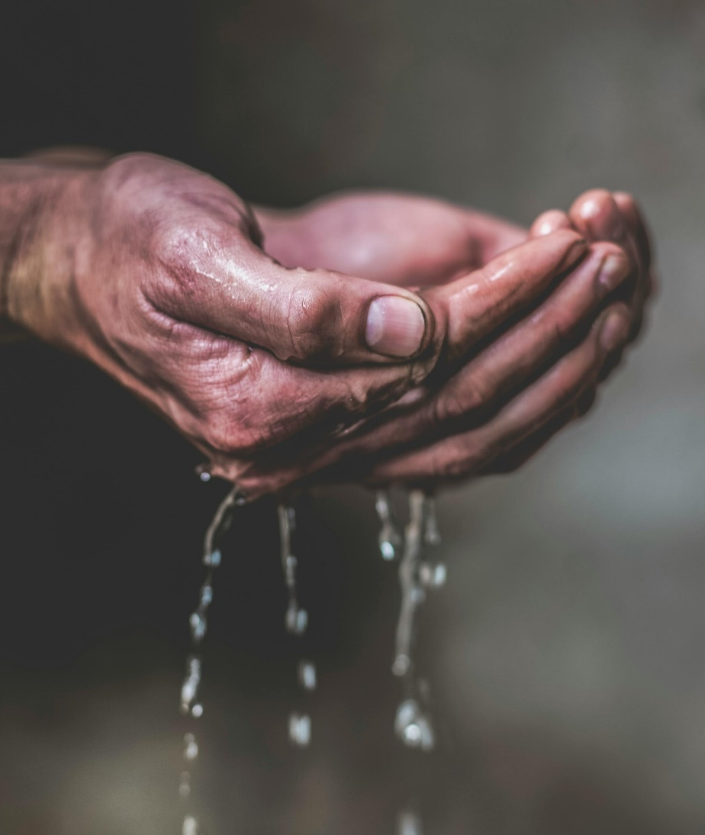
Hadith 2: To the right, then to the right. إِلَى الْيَمِينِ فَإِلَى الْيَمِينِ (Muslim/Bukhari)
• Context: One Sahabi had some Sheep’s milk mixed with water, and Prophet صلى الله عليه وسلم drank from it.
Abu Bakr was on his left; Bedouin was on his right. Prophet SAW gave it to Bedouin saying the above hadith (right side) to clarify what he was doing.
We know that the Most superior after the prophets is Abu Bakr RA but still gave it to his right!
• Explanation: tayaamum (beginning with the right) is of the Sunnah, mustahabb

Slide 7

Hadith 2:
Another Hadith: “Begin with the elders” How do we reconcile?: seating was not as such to pass to the right.
It applies to water/food and any other items
One time the prophet SAW asked a slave on his right permission to give it to others. But just be wary they are not put off by you asking.
Sunnat will always take precedent over any thing else. Respect the sunnah by acting upon it.
Takeaway: Respecting (acting upon) the Sunnah is greater than respecting any person.

Slide 8

Hadith 3: Your kin, your kin! أَرْحَامَكُمْ، أَرْحَامَكُمْ (Ibn Hibban, Saheeh)
Context: The Prophet صلى الله عليه وسلم was ill and he said this, meaning one should keep good family ties. Direct family and extended family.
E.g., A man can't marry 2 sisters at one time due to the keeping family ties. Just because a mere possibility that this could happen.
If there is too much socializing between family members can lead to problems so keeping a healthy balance between family is very important.

Slide 9

Hadith 3:
Quran Ra’ad 13:21 : …Those who join what Allah has commanded to join…these are the people of understanding
Hadith: …anyone who believes in the Allah and the last day should maintain his ties in kinship.
Hadith: …whoever desires expansion of his provisions (rizq)/to have the best of his life prolonged should maintain family ties. Barakah/long life
Hadith: those who maintain ties of kinship isnt the person who because others do it to broken, he does it back, rather when it is broken, he fixes it.
This Photo by Unknown Author is licensed under CC BY-SA-NC

Slide 10

Hadith3:
Hadith: Kinship is suspended from the Throne of Allah and says: Allah will connect with all those who connect ties and sever with all those that sever ties.
Our relationship with Allah can depend on your family ties!
Hadith: The one who sever ties will not enter Jannah.
Zakat: Giving to poor relatives = 1 reward for poor, 1 reward for relatives.
It is a major sin to cut off ties with one’s kin, and one should do his/her best to maintain them
• Takeaway: Look after relatives financially if they’re in need.

